Slide 1

Object Oriented Programming
Structural Design Patterns: Adapter
IT560
Sourish Dasgupta
Assistant Professor, DA-IICT, Gandhinagar
https://daiict.ac.in/faculty/sourish-dasgupta

Slide 2
Creational Design Pattern : Object creation is just the first step
Do not help in structuring relationships between objects to form larger more complex objects
Do not help in avoiding tightly coupled objects (just takes care of tightly coupled client-server relationships)
Do not help much in object code duplication (just focuses on reducing construction code duplication)
IT560: Structural Design Patterns: Adapter
Sourish Dasgupta

Slide 3
Structural Design Pattern: A game of lego
The art of how to make complex, larger objects
Requires perfect “fitting” of the components (smaller objects) - component relationship
Requires solving incompatibility between components
IT560: Structural Design Patterns: Adapter
Sourish Dasgupta

Slide 4
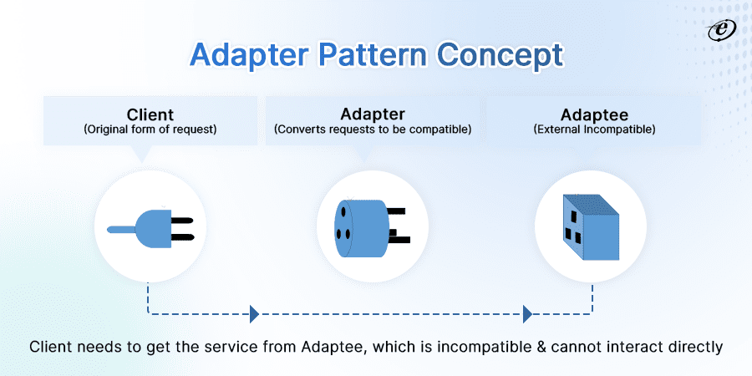
Adapter Design Pattern : Making objects compatible
IT560: Structural Design Patterns: Adapter
Sourish Dasgupta

Slide 5
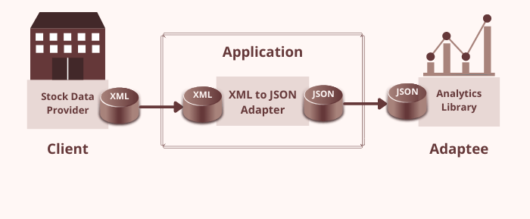
Adapter Design Pattern : Making objects compatible
IT560: Structural Design Patterns: Adapter
Sourish Dasgupta

Slide 6
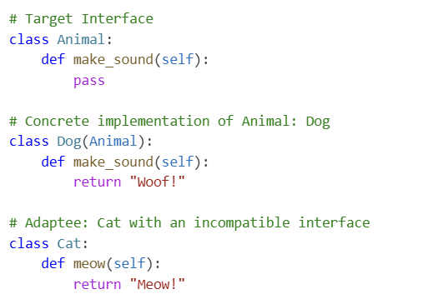
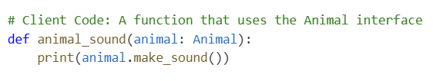
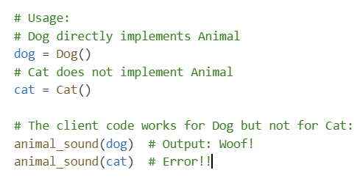
Client incompatible with newly introduced Class
IT560: Structural Design Patterns: Adapter
Sourish Dasgupta

Slide 7
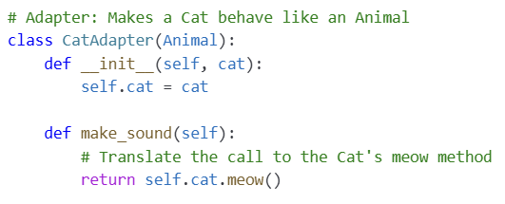
Adapter Design Pattern : Making objects compatible
IT560: Structural Design Patterns: Adapter
Sourish Dasgupta

Slide 8
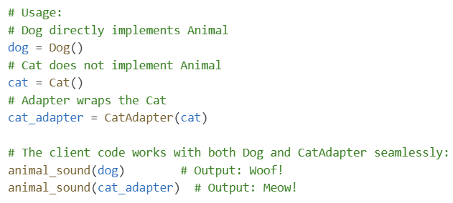
Adapter Design Pattern : Making objects compatible
IT560: Structural Design Patterns: Adapter
Sourish Dasgupta

Slide 9
Adapter: Key Takeaways
Advantage | Description
Interface Compatibility | Allows disparate interfaces to work together without modifying existing code.
Reusability | Enables the reuse of legacy or third-party classes by adapting them to a required interface.
Decoupling | Reduces direct dependencies between components, making them easier to maintain and extend.
Flexibility | Simplifies integration of new components or systems, even if their interfaces differ.
Scalability | Facilitates system growth by allowing components to be added or replaced with minimal disruption.
IT560: Creational Design Patterns: Prototype
Sourish Dasgupta

Slide 10
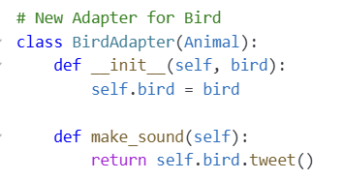
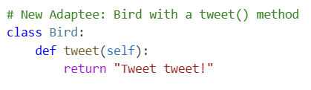
Adapter Design Pattern : New adapter for each adaptee
IT560: Structural Design Patterns: Adapter
Sourish Dasgupta

Slide 11
Can we do better?
IT560: Structural Design Patterns: Adapter
Sourish Dasgupta

Slide 12
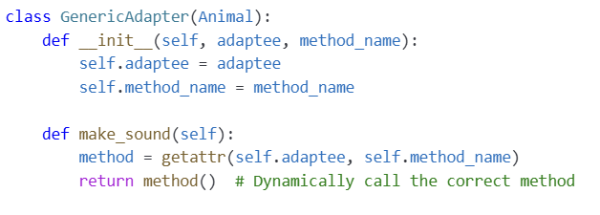
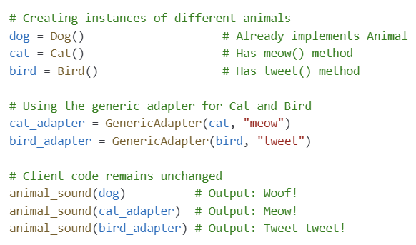
Adapter Design Pattern : Generic adapter for all adaptee
IT560: Structural Design Patterns: Adapter
Sourish Dasgupta

Slide 13
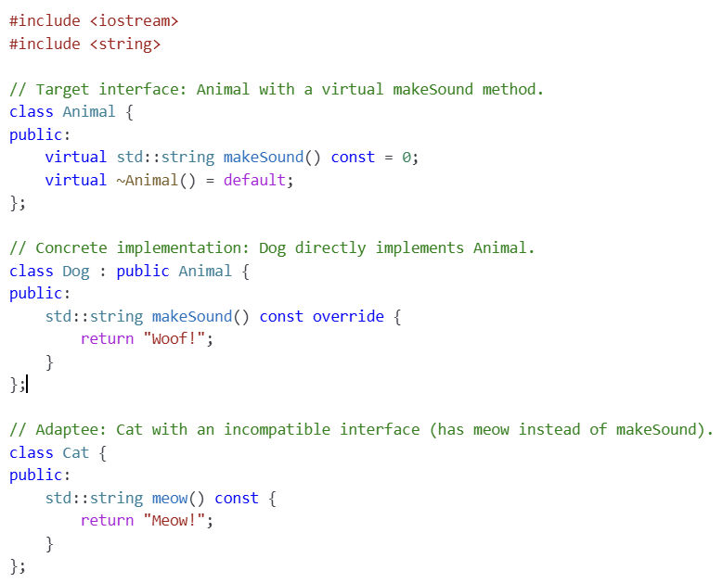
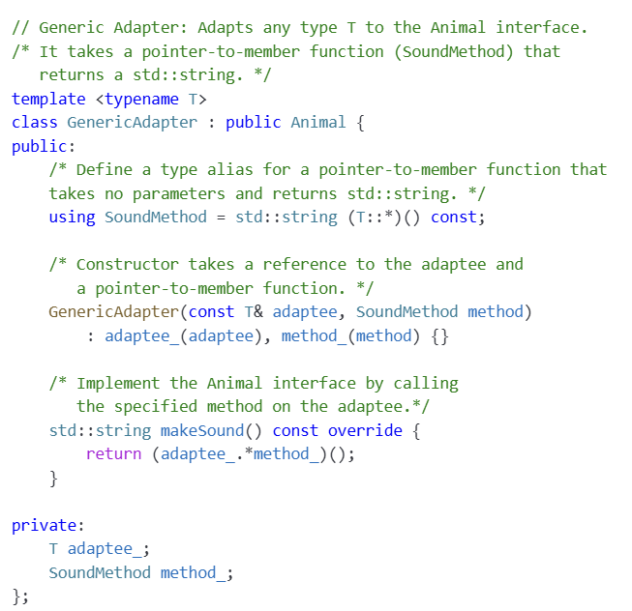
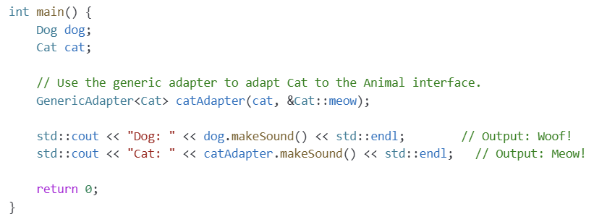
Adapter Design Pattern : Let’s go C++!!
IT560: Structural Design Patterns: Adapter
Sourish Dasgupta

Slide 14
Is adapting always good?
IT560: Structural Design Patterns: Adapter
Sourish Dasgupta

Slide 15
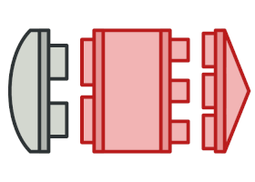
Adapter: Cautionary comments
Con | Description
Increased Complexity | Adds extra layers of abstraction that may complicate system understanding.
Maintenance Overhead | Additional adapter code must be maintained, especially if underlying interfaces change
Masking Design Issues | Can hide underlying design flaws by serving as a quick fix rather than addressing core issues
Complex Testing | More layers (client, adapter, adaptee) mean additional testing is required to ensure proper integration
IT560: Creational Design Patterns: Prototype
Sourish Dasgupta

